Slide 1
Motivation and School Structure
Dr. Umberto Michelucci
umberto.michelucci@toelt.ai

Slide 2
Thanks to…
Organisers
Susanna Bisogni
Adriana Gargiulo
Marco Scodeggio
Marco Fumana
And of course to Bianca Garilli e Andrea del Luca. Without their support this would not have been possible.
And of course a big thanks to the entire INAF for the support, trust and welcome.

Slide 3
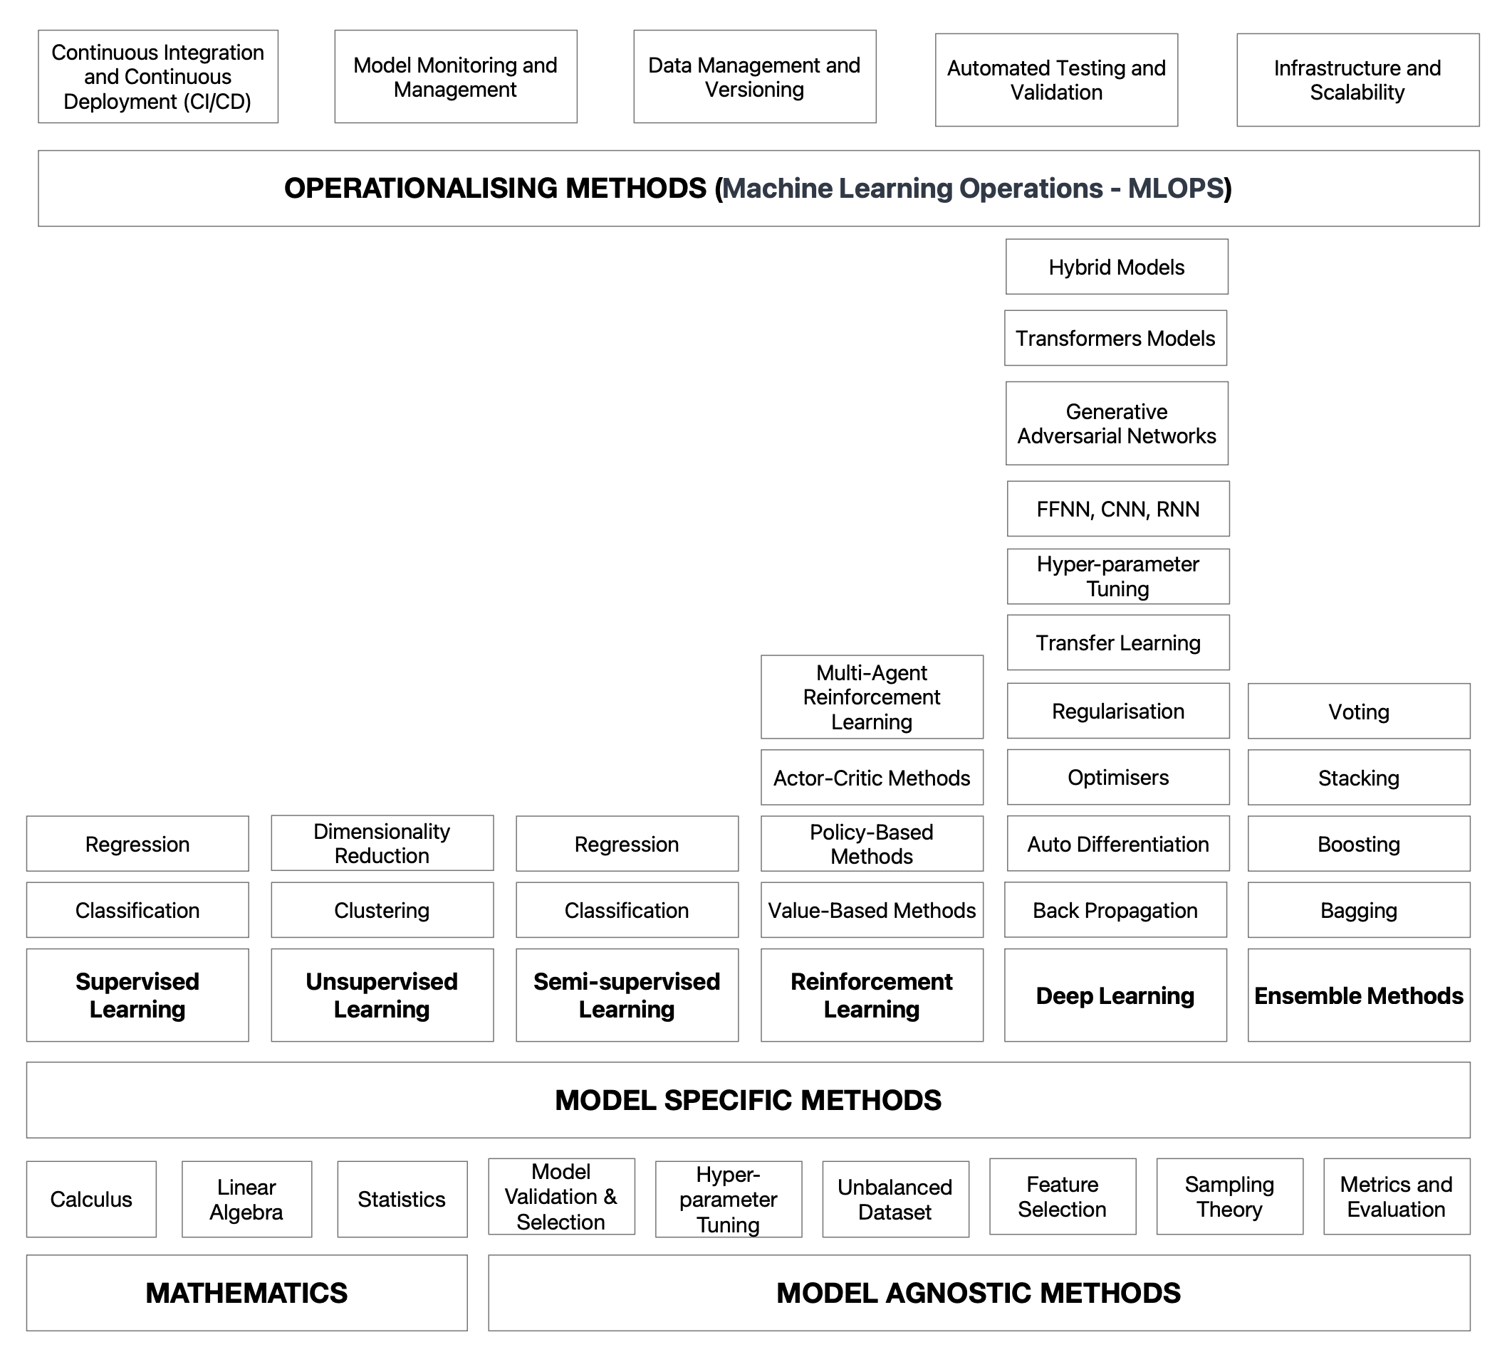
Machine Learning Concepts Taxonomy

Slide 4
Machine Learning Concepts Taxonomy What we will cover

